Slide 1
Real-time Eulerian Water simulation using a restricted tall cell grid Nuttapong Matthias

Slide 2
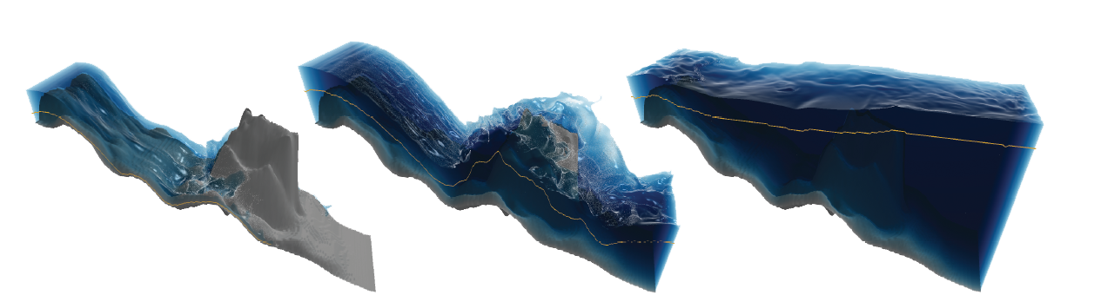
Tall cells
Cubic cells

Slide 3
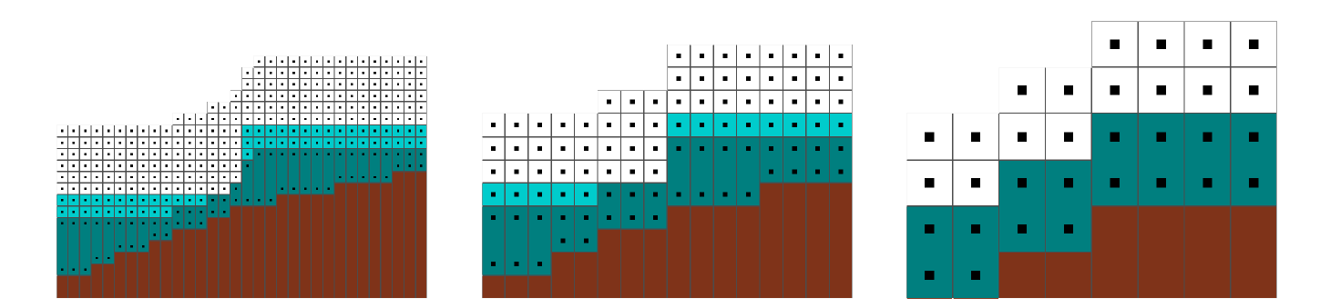

Slide 4
Summarize
Tall cell grid data structure
Modified level set method
Multigrid Poisson solver

Slide 5



Methods

Slide 6
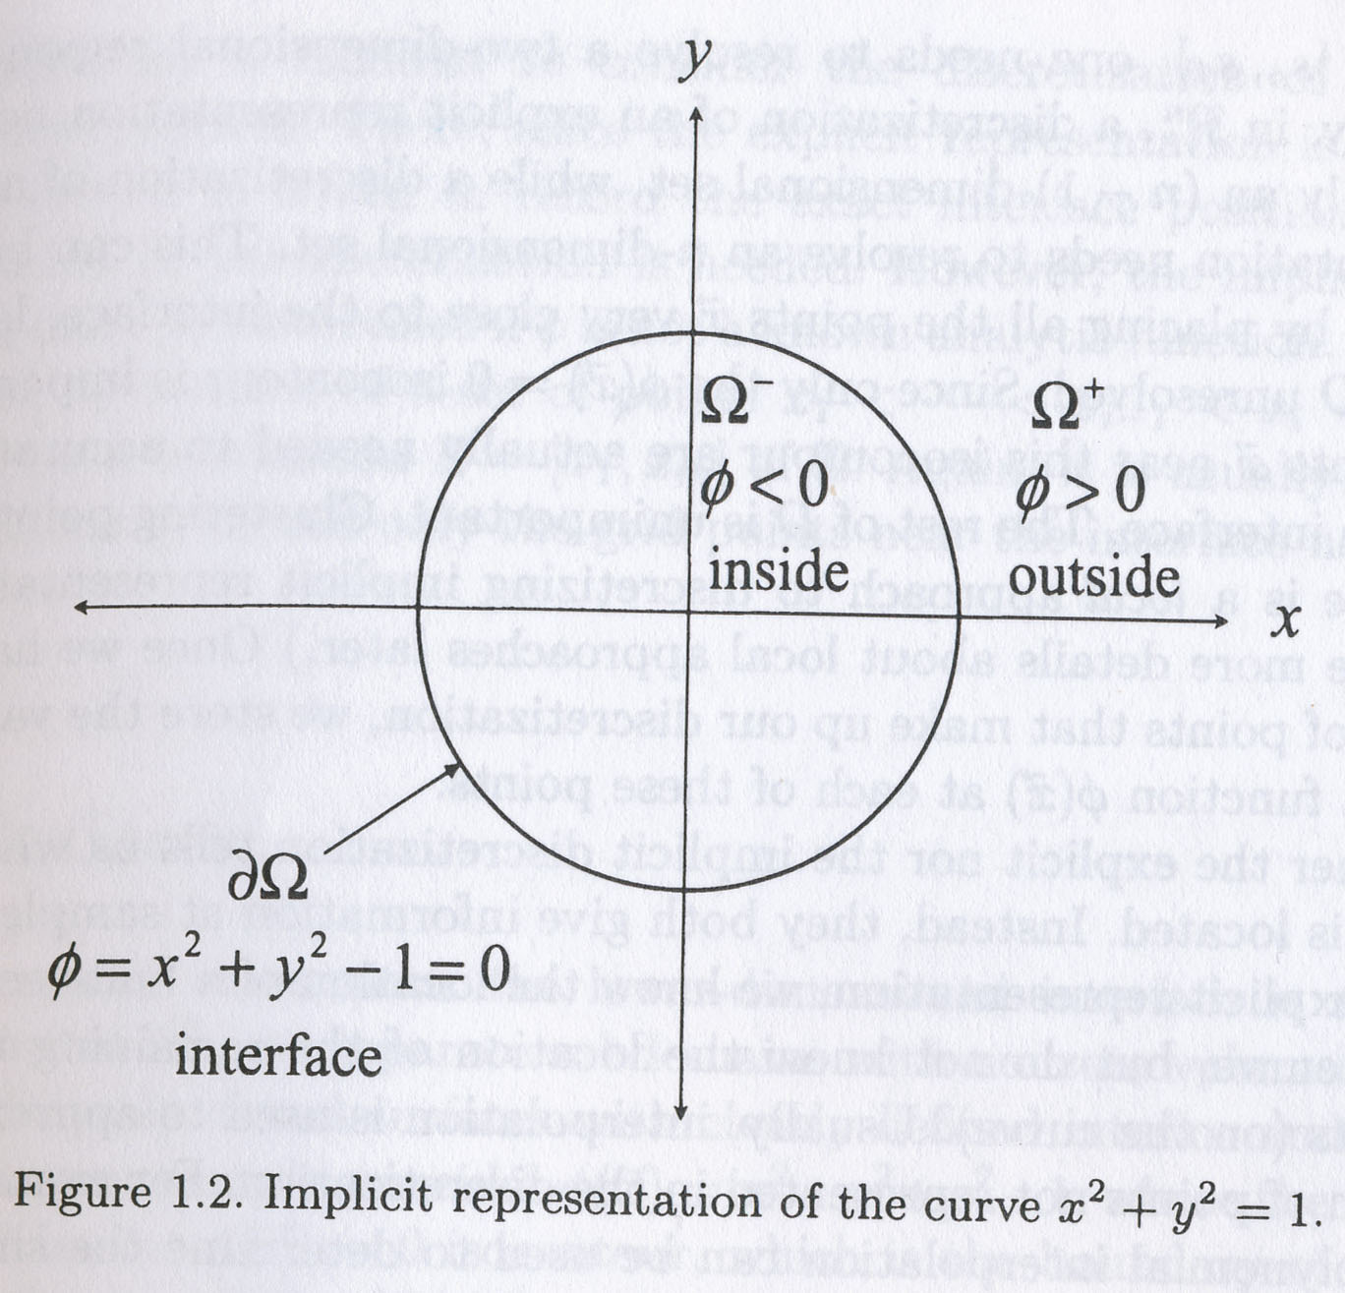
Level Set

Slide 7
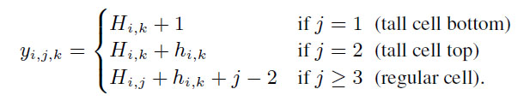
Discretization
Collocated grid
y-coordinate of uncompressed position of element is

Slide 8
Algorithm
For each time step
Velocity extrapolation
Level set reinitialization
Advection and external force integration
Remeshing
Incompressibility enforcement

Slide 9
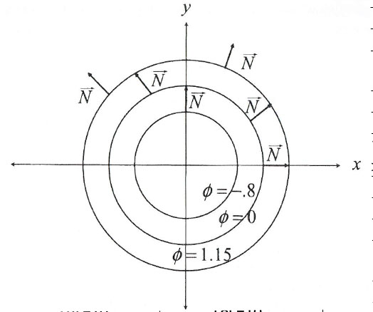

1.Velocity Extrapolation
Eikonal solver on GPU [Jeong 2007]
Narrow band [Enright 2002]

Slide 10
2.Level Set Reinitialization
Recompute signed distance field
Run reinitialization step only every ten frames.
Don’t modify the values next to the surface in order to avoid moving it.
Clamp the value next to surface to not exceed the grid space h

Slide 11


3. Remeshing
Define new where
Constraints:
At least Gl regular cells below liquid
At least Ga regular cells above
The heights of adjacent tall cells must not differ than D

Slide 12

4. Enforcing Incompressibility
Ghost-fluid method [Enright 2002]
Solid fraction [Batty 2007]

Slide 13
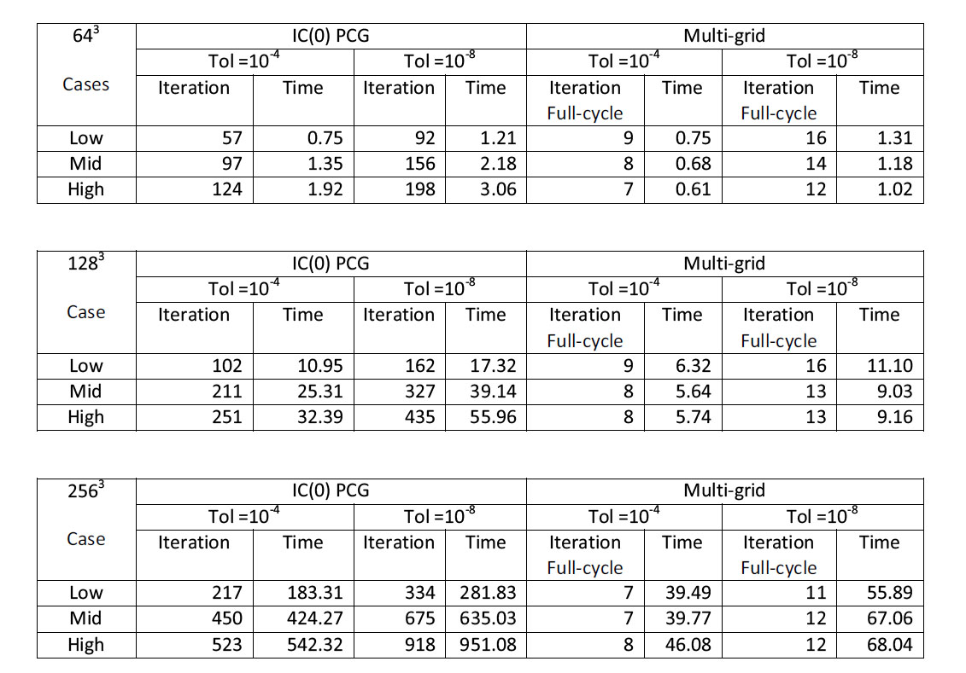
Multigrid vs PCG(Preconditioned conjugate gradient)

Slide 14


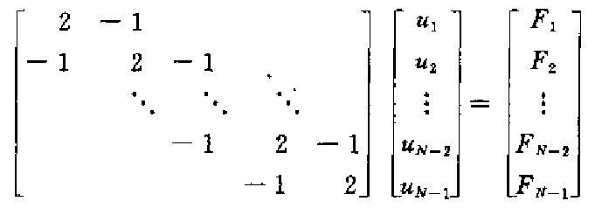
Multigrid

Slide 15


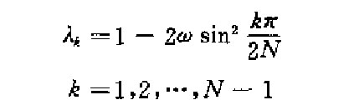

Slide 16
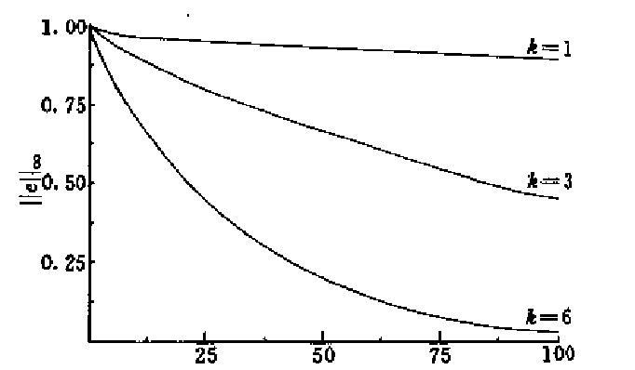
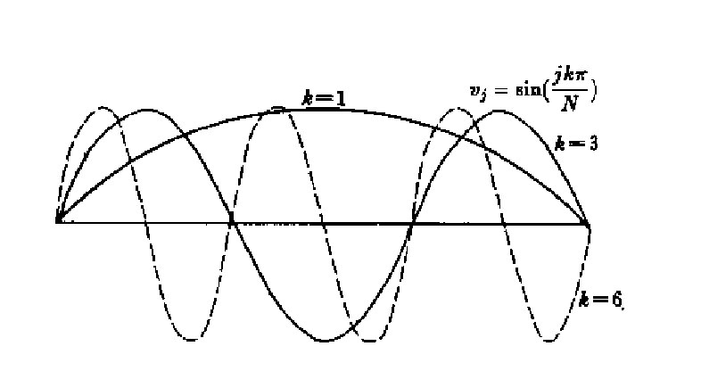

Slide 17
